Slide 1
UNIT– 4 Series Completion, Analogy, Classification, Coding & Decoding
SUBJECT : QUANTITATIVE APTITUDE AND LOGICAL REASONING
DEPARTMENT OF MATHEMATICS SNIST

Slide 2

Number Series

Slide 3

4) 10000+10%, 11000-10%, 9900+10%, 10890-10%, 9801?
Sol) Clearly alternatively we add and subtract 10% of a term to obtain the next term of the series.
Thus, 10K+(10%of 10K)=11000, 11000-(10% of 11000)=9900, 9900+(10% of 9900)= 10890, 10890-(10% of 10890)= 9801.
so, the missing term is 9801+(10% of 9801)= 9801+980=10781.
5) 0, 6, 24, 60, 120, 210?
Sol) Clearly the given series is
$$1^{3}−1, 2^{3}−2,3^{3}−3,4^{3}−4,5^{3}−5{, 6}^{3}−6,…..$$
Missing term = $7^{3}−7=343−7=336$

Slide 4

Elementary Idea of Progressions
Arithmetic Progression:
The progression of the form a, a+d, a+2d, a+3d, ….. ,is known as an A.P with first term = a, and common difference = d.
In A.P we have nth term = a+(n-1)d
b) Geometric Progression:
The progression of the form a, ar, $ar^{2},ar^{3}…$ is known as a G.P with first term = a, and common ratio is = r

Slide 5

Problems
1) In the series 357, 363, 369,….., what will be the 10th term?
Sol) The given series is in A.P with a=357, d=6
10th term = 9+(10-1)x6=411
2) How many terms are there in the series 201, 208, 215, ……, 360?
Sol) A.P a=201, d=7
Let the no of terms be n
Then 369 = 201+(n-1)x7 or n = 25
3) In the series 7, 14, 28, ….. , what will be the 10th term?
Sol) Clearly 7 x 2=14, 14x2=28, …….G.P
A=7, r=2
10th term = $ar^{(10−1)}=ar^{9}=7×2^{9}=7×512=3584$

Slide 6
Triangular pattern Series
Sometimes the difference between the consecutive terms of a series, again form a series. The difference between the consecutive terms of the new series so formed, again a series. This pattern continues till we attain a uniform difference between the consecutive terms of the series.

Slide 7
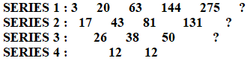
Problems
1) 3, 20, 63, 144, 275?
Sol) As discussed above, we may label the given series as
Series 1 and then form series 2 to 4 as shown below
Clearly the pattern in series 3 is +12
So, the missing term in series 3 is 50+12=62
Missing term in series 2 is 131+62=193
Missing term in series 1 is 275+193=468
Direct Method:
Clearly we have missing term = 275+(131+50+12) = 468
All squares, all cubes, all primes, x constant no, + constant no, - constant no.

Slide 8

Problems
1) 1, 9, 25, 49, ?, 121?
Sol) The series consists of squares of consecutive odd nos
$$1^{2},3^{2},5^{2},7^{2},9^{2}, {11}^{2}……$$
2) 4, 7, 12, 19, 28?
Sol) +3, +5, +7, +9, +11,….. i.e., 28+11=39
3) 11, 13, 17, 19, 23, 25?
Sol) +2, +4, +2, +4, +2, +4, ….. i.e., 25+4=29
4) 120, 99, 80, 63, 48?
Sol) -21, -19, -17, -15,… i.e., 48-13=35
5) 4832, 5840, 6848?
Sol) +1008 i.e., 6848+1008= 7856

Slide 9

6) 165, 195, 255, 285, 345?
Sol) Each no of the series is 15 multiplied by a prime no
i.e., 15x11, 15x13, 15x17, 15x19, 15x23…..
i.e., 15x29 = 435
7) 2, 12, 36, 80, 150?
Hint: Triangular Pattern series
Sol) $1^{2}×2, 2^{2}×3, 3^{2}×4,…. i.e., 252$

Slide 10
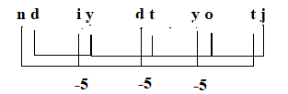
Alphabet series
1) What terms will fill the blank spaces?
Z, X, V, T, R,__, __
Sol) Alternate letters in reverse order i.e., P,N
2) nd,iy, dt, yo, tj,_?
Sol) Clearly, the 1st & 2nd letters of each term are moved 5 steps backward to obtain the corresponding letters of the next term.

Slide 11
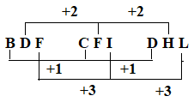
3) BDF, CFI, DHL,?
i.e., EJO
4) ABD, DGK, HMS, MTB, SBL?
Sol) Position 1: +3, +4, +5, +6, +7 ------------ Z
Position 2: +5, +6, +7, +8, +9 --------------- K
Position 3: +7, +8, +9, +10, +11-------------- W
Therefore ZKW.

Slide 12
5) U, O, I ,?, A
Sol) Vowels in reverse order.
Therefore the missing letter is E

Slide 13
Alpha Numeric
1) Find the wrong term in the letter number series given below
G4T, J10R, M20P, P43N, S90L
Sol) 1: +3; 3: -2
2: x2+1, x2+2, x2+3, x2+4
Therefore correct word is J9R

Slide 14
Analogy
Common Relationship:
Countries and capital
State and capital
Country and currency
Instruments and measurement
Quantity and unit
Individual and group

Slide 15
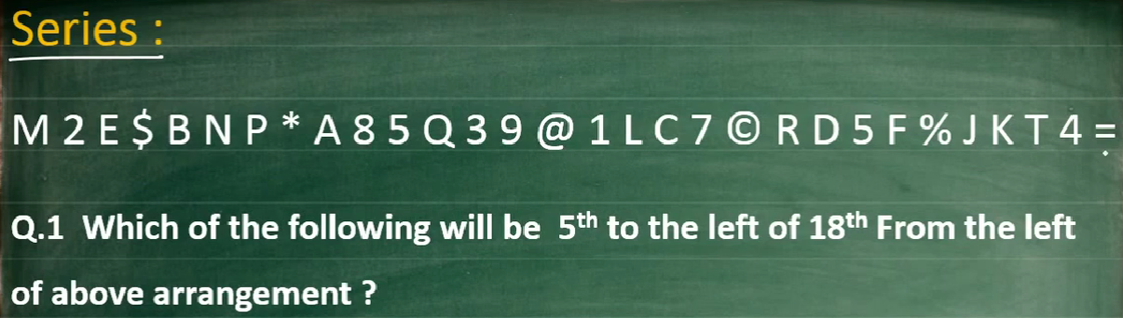
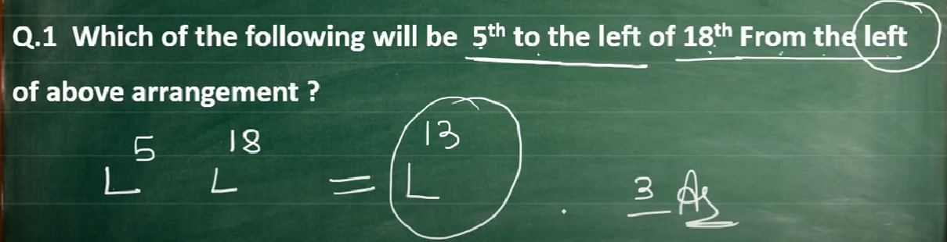
ALPHA NUMERIC SERIES

Slide 17
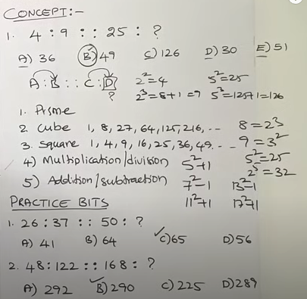
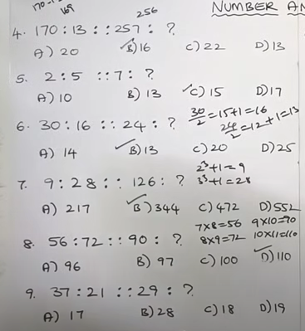
NUMBER ANALOGY

Slide 18
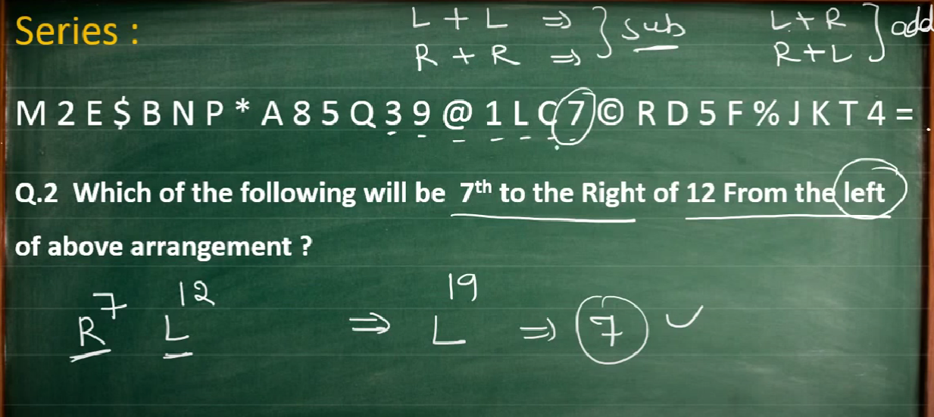

Slide 19
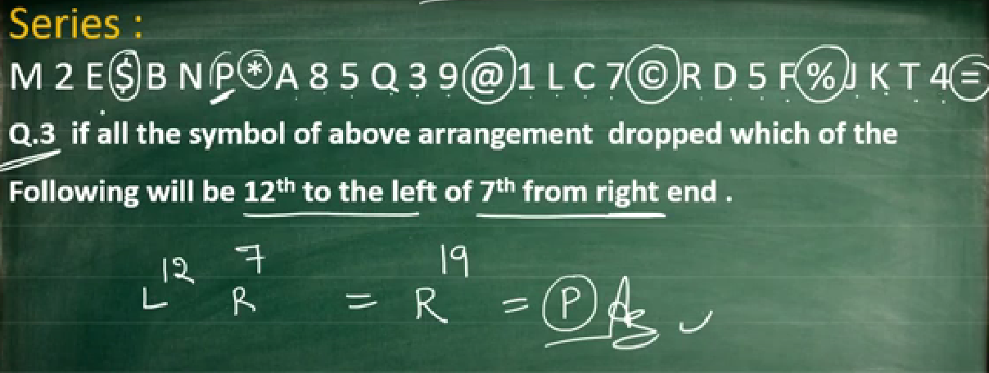

Slide 20
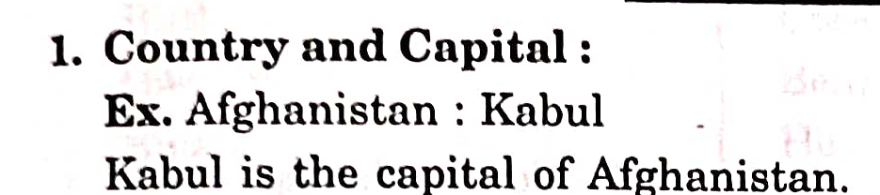
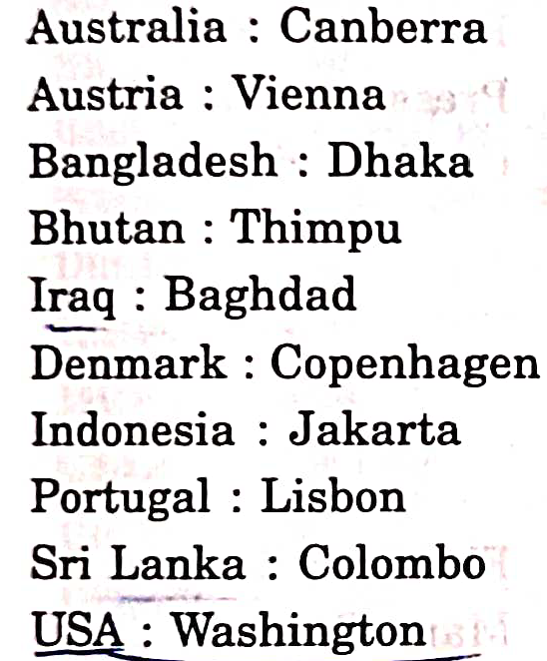
Analogy

Slide 21
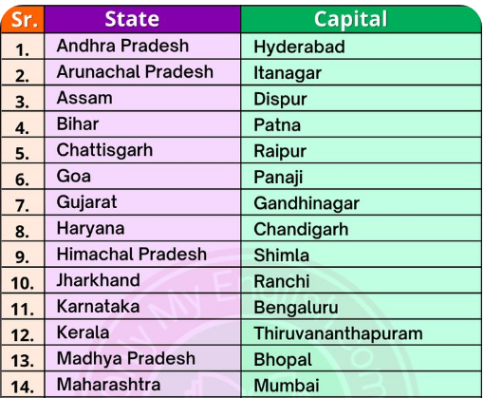
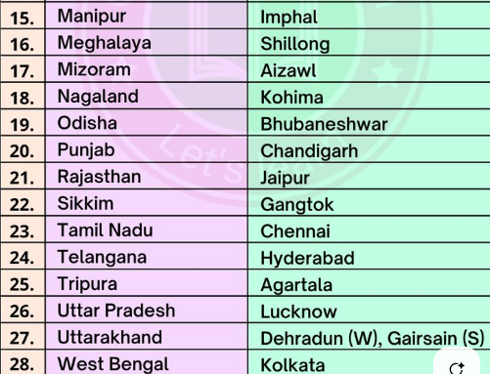

Slide 22
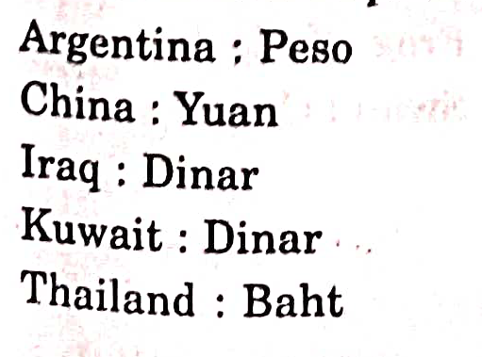

Slide 23
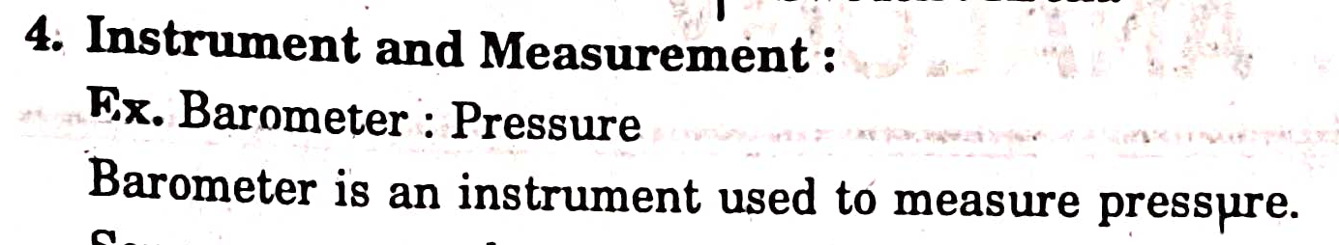
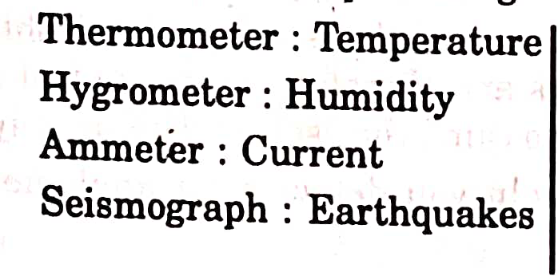

Slide 24
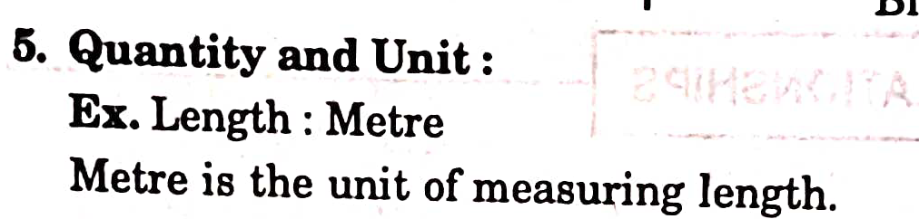
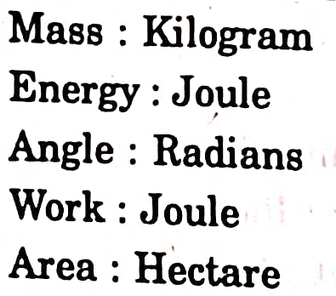
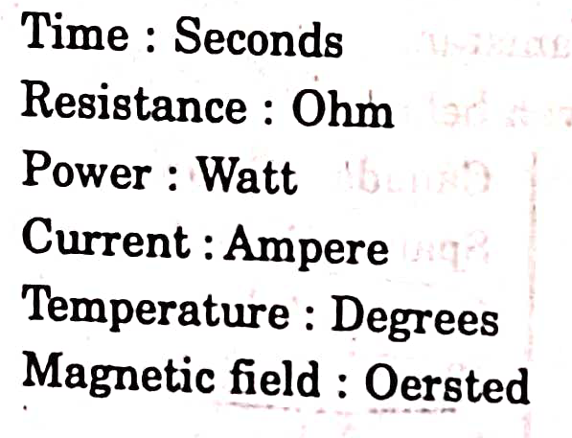

Slide 25
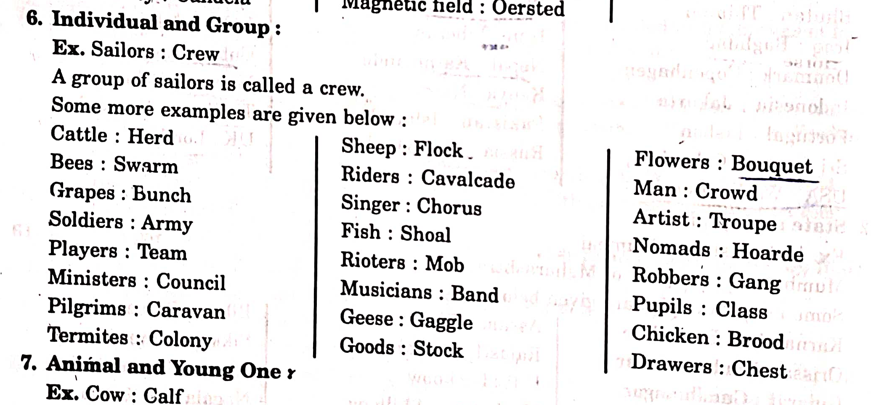

Slide 26
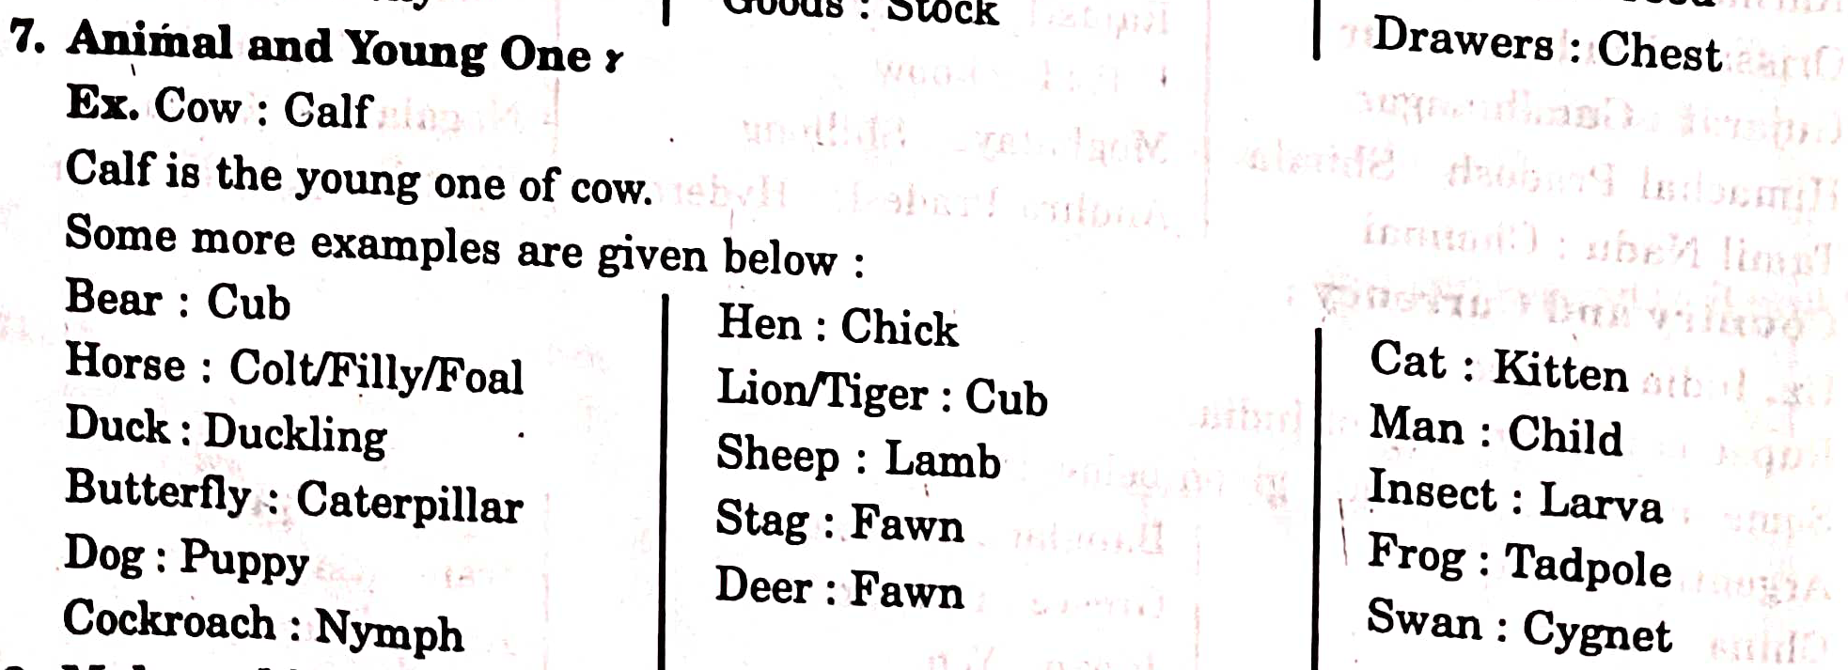

Slide 27
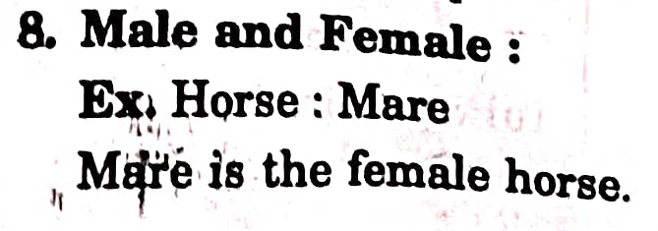
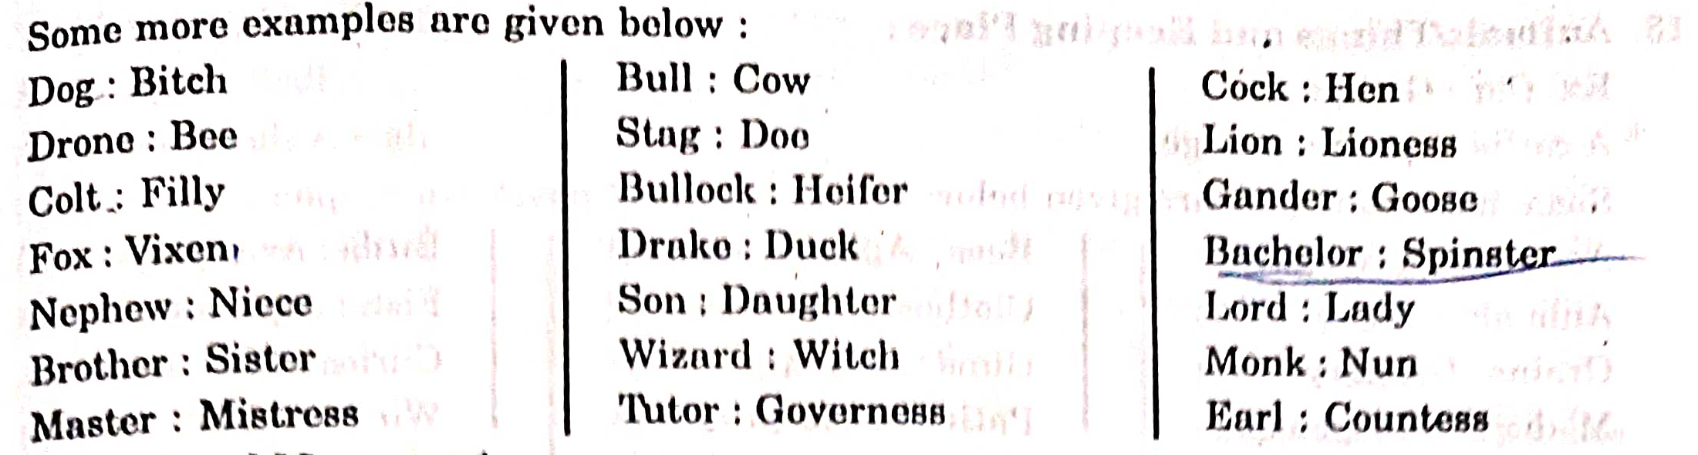

Slide 28
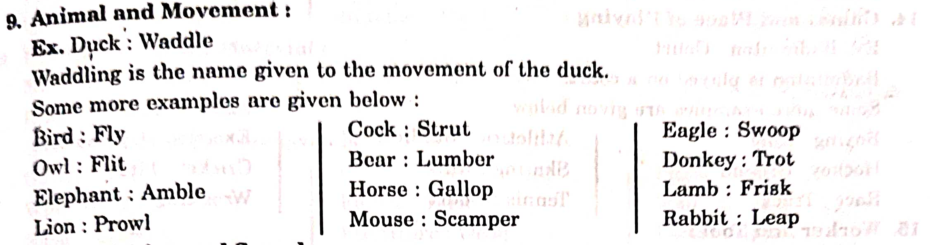

Slide 30
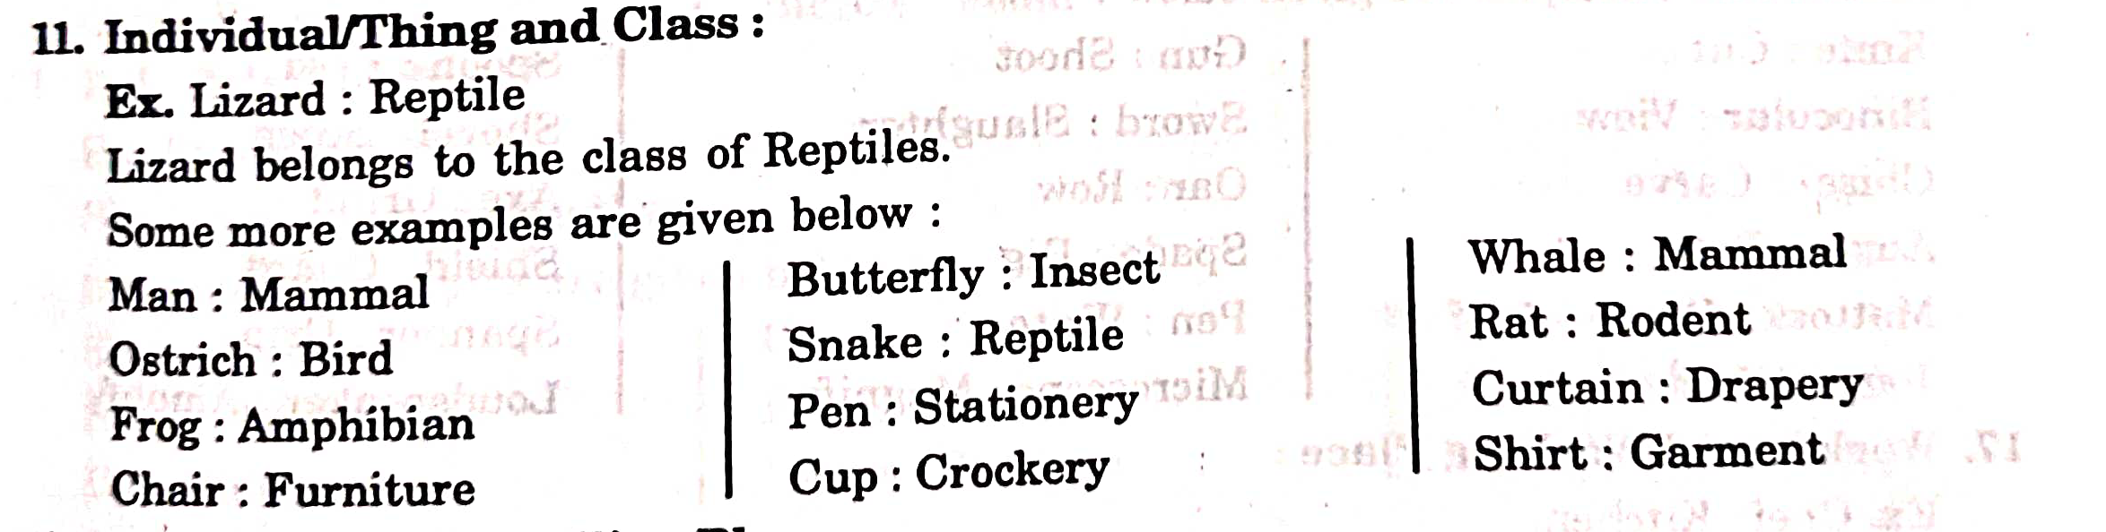

Slide 31
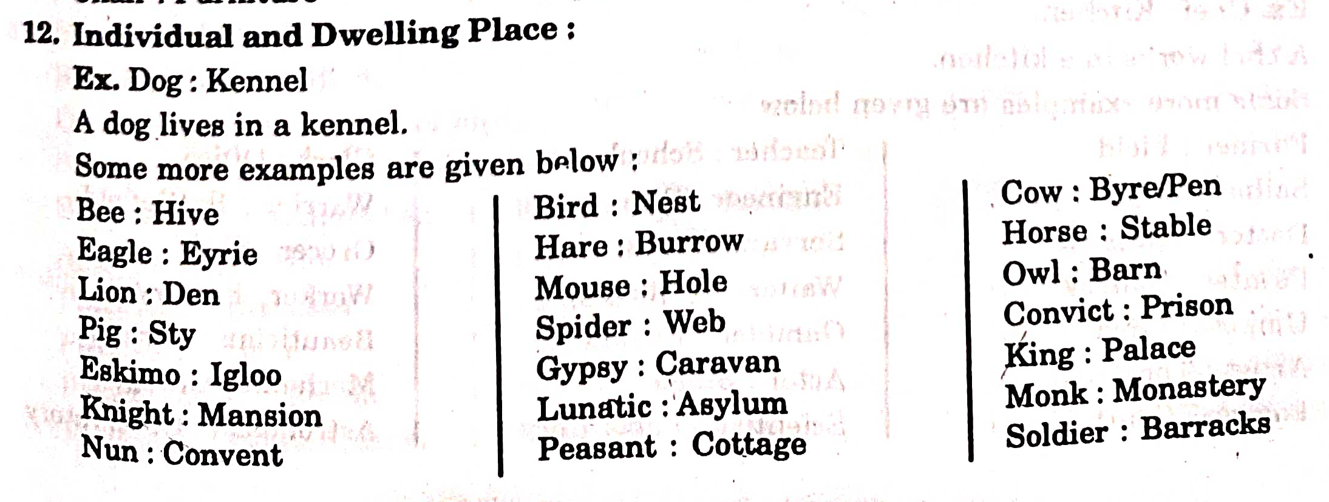

Slide 32
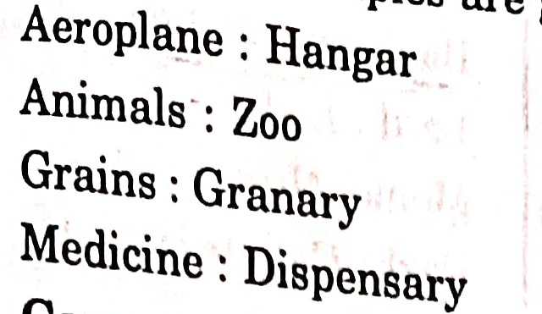
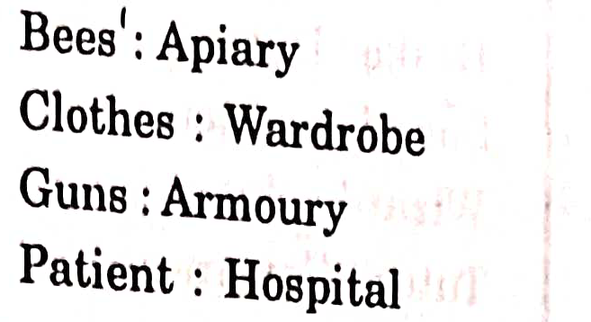
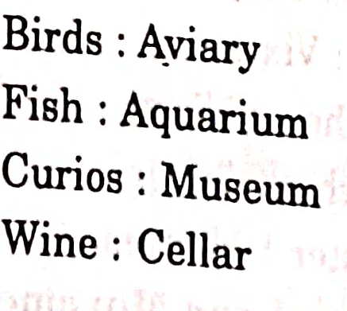

Slide 33
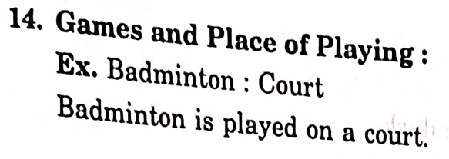
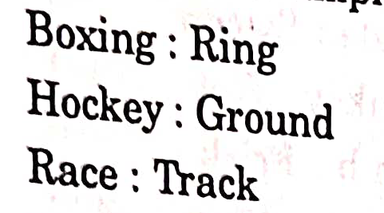
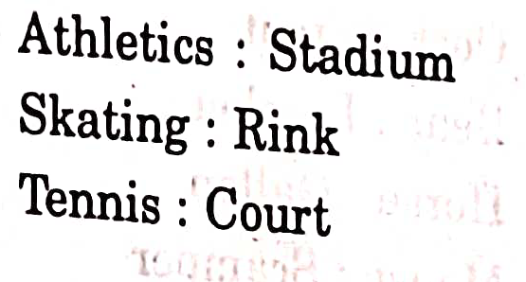
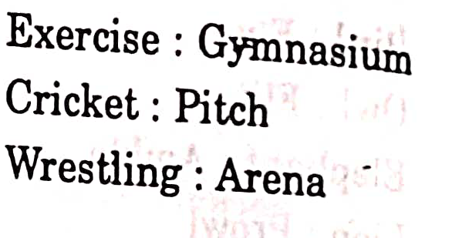

Slide 34
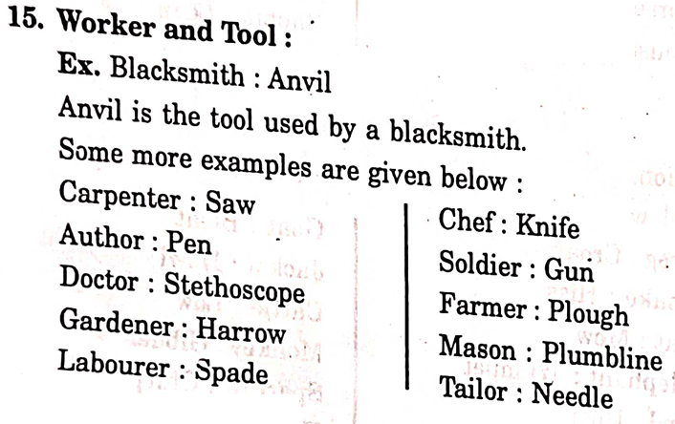
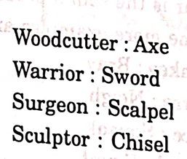

Slide 35
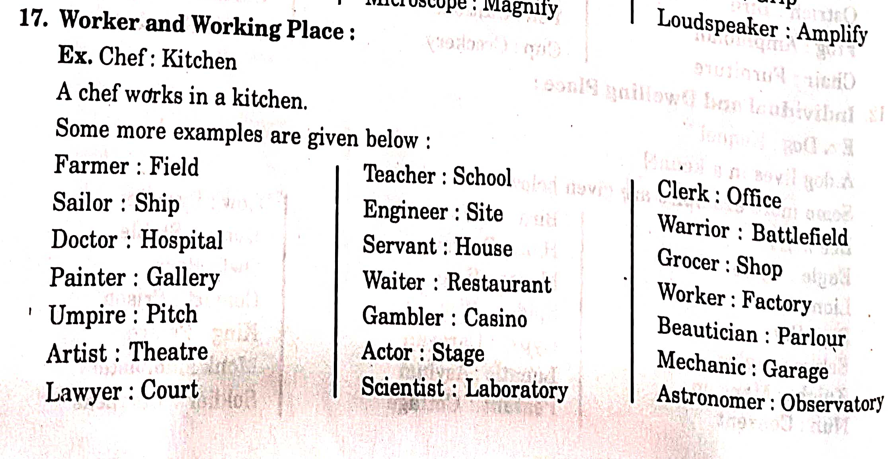

Slide 36
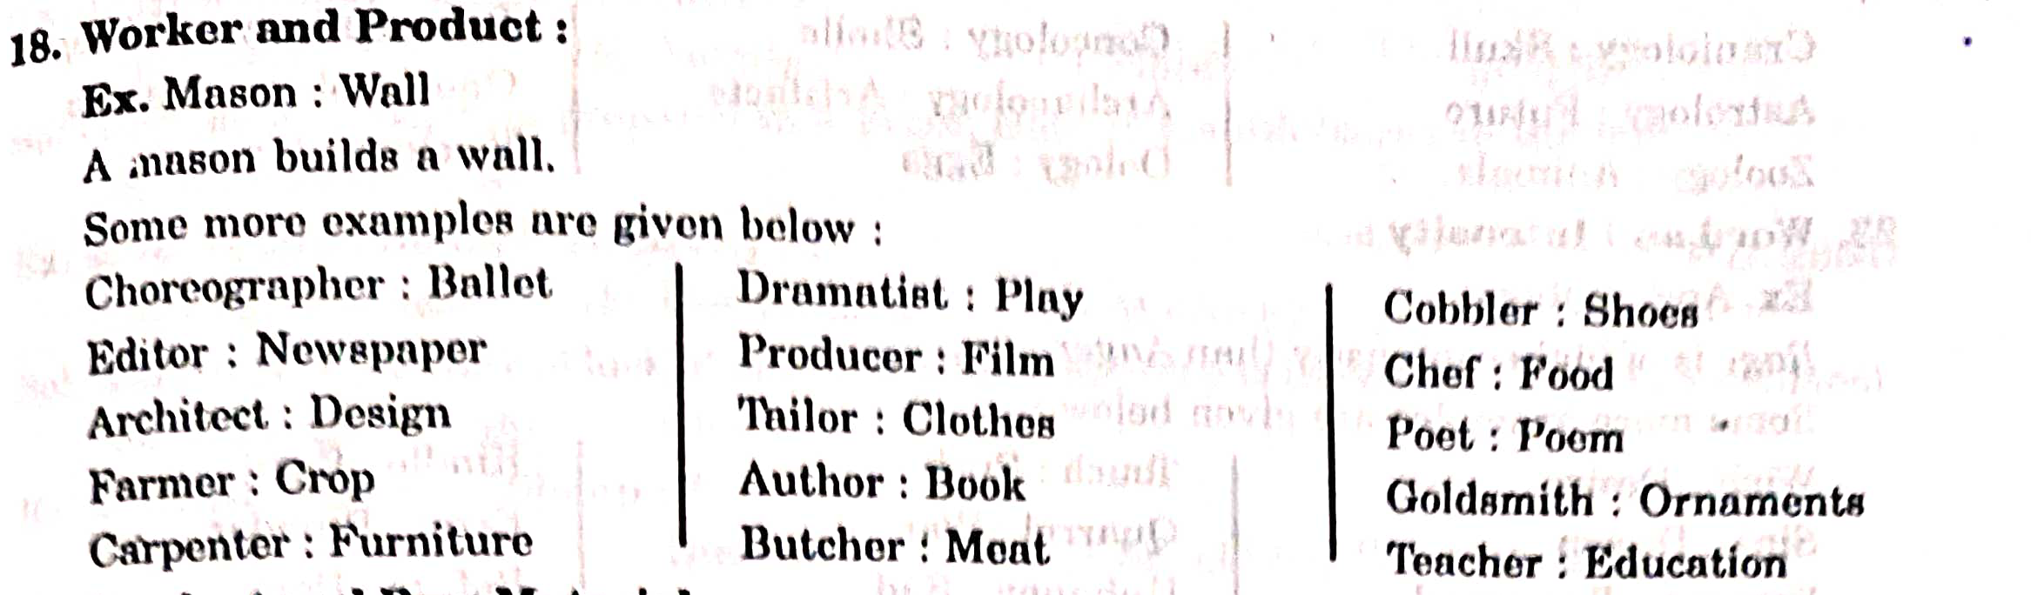
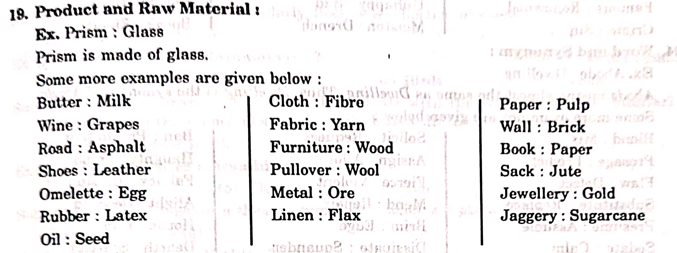

Slide 37
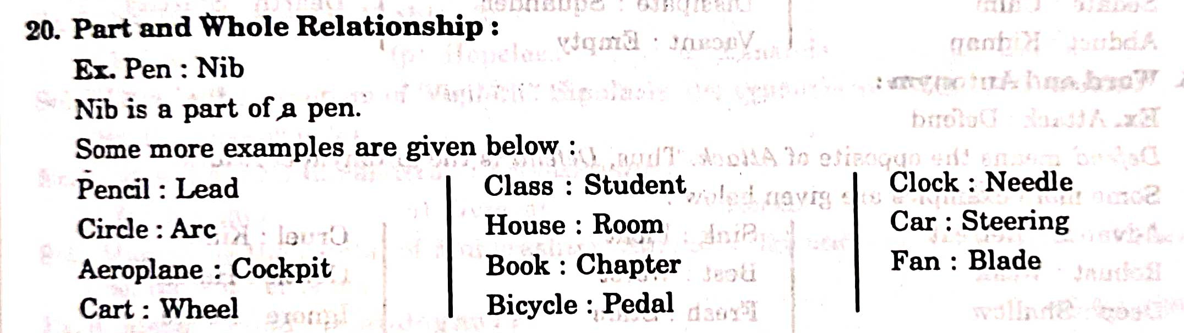
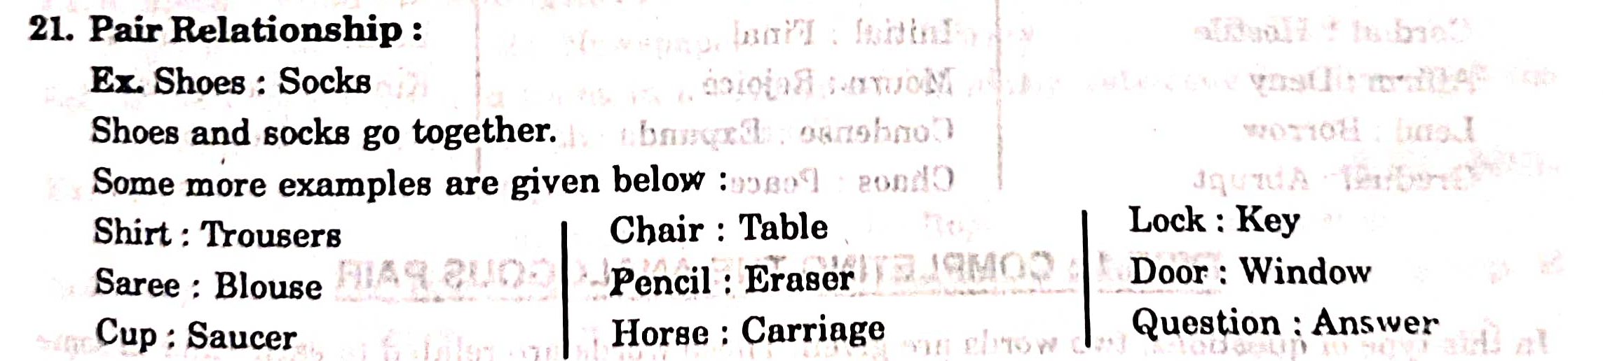

Slide 38
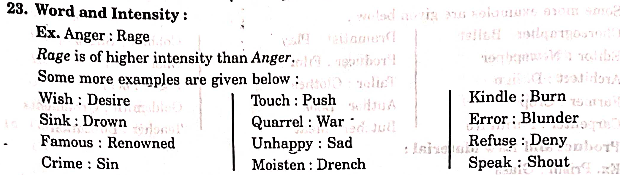

Slide 39
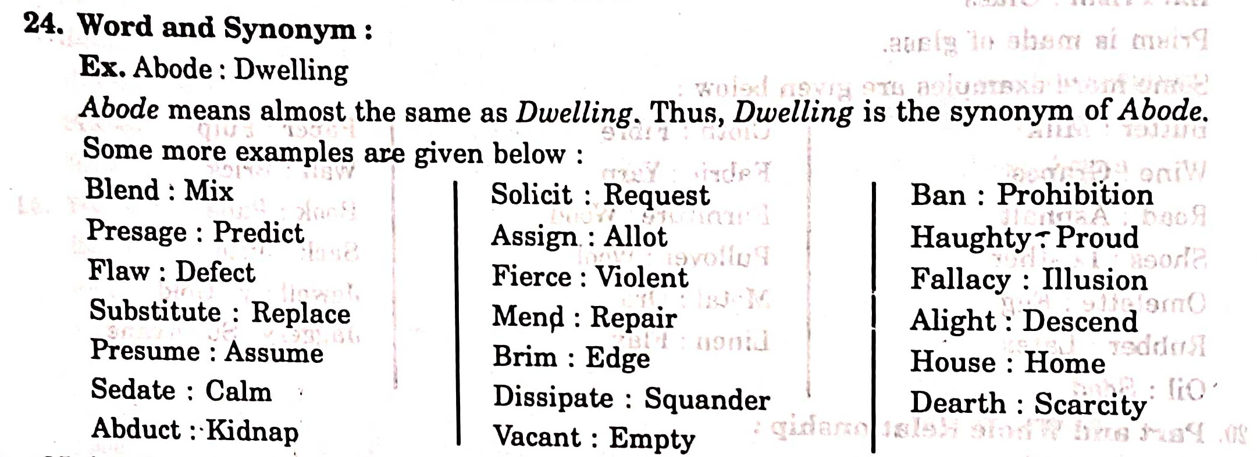

Slide 40
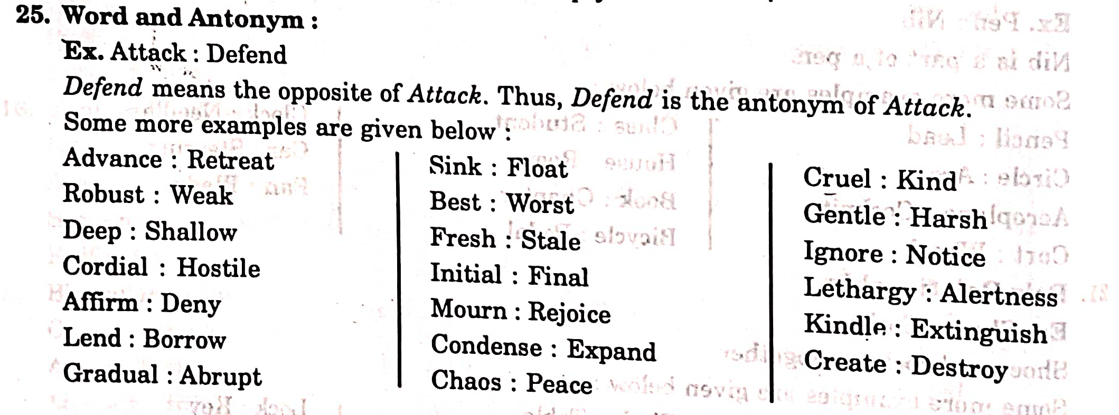

Slide 41
Completing the Analogous pair
In this type of questions 2 words are given. These words are related to each other in some way. Another word is given. The candidate is required to find out the relationship between the first two words and choose the word from the given alternatives, which bears the same relationship to the third word as the first two bear.

Slide 42
1) GIANT : DWARF : GENIUS?
Sol) DWARF is the antonym of giant similarly the antonym of GENIUS is IDIOT.
2) ANAEMIA : BLOOD :: ANARCHY
Sol) ANAEMIA is the state of lack of blood similarly ANARCHY is the state of lack of GOVERNMENT.
3) SQUAR : DIAMOND : : CIRCLE?
Sol) 2nd is the shape obtained by pulling the opposite ends of the first. i.e., OVAL
4) BOAT: ORE : : BICYCLE?
Sol) Second denotes that part of the 1st on which the effort is applied. i.e., PEDAL
5) BOOK: PUBLISHER : : FILM?
Sol) The production of 1st is done by the 2nd that is PRODUCER

Slide 43
6) MONDAY: SATURDAY : : THURSDAY: ?
Sol) 2nd is five days ahead of the 1st i.e., TUESDAY
7) COAL: HEAT : : WAX: ?
Sol) 1st is burnt for producing the 2nd i.e., LIGHT
8) PLANT:TREE : : GIRL:?
Sol) 1st grows into the 2nd i.e., WOMAN
9) CAR: GARRAGE : : AEROPLANE:?
Sol) 1st is temporarily parked in the 2nd i.e., HANGAR
10) RAT:CAT : : WORM:?
Sol) 2nd feeds on the 1st i.e., BIRD.

Slide 44
DIRECT/SIMPLE ANALOGY
1) Neckless is related to jewelry in the same way shirt is related to ?
Sol) 2nd denote the group to which the 1st belongs i.e., APPAREL
2)Impossible is related to feasible in the same way as theoretical is related to ?
Sol) The words in each pair are antonyms of each other i.e., PRACTICAL
3)Earth is related to axis in the same way wheel is related to ?
Sol) 1st rotates about the 2nd i.e., ROAD
4) Laborer is related to wages in the same way entrepreneur is related to ?
Sol) 1st earns in the form of 2nd i.e., PROFIT
5) Flower is related to petal in the same way book is related to ?
Sol) Number of petals constitute a flower. Similarly no of PAGES constitutes a book.

Slide 45
Choosing the Analogous Pair
In this type of questions, a pair of words are given, followed by 4 pairs of words as alternatives. The candidate is required to choose the pair in which the words bears the same relationship to each other as the words of the given pair bear.

Slide 46
Problems
1) Darkness : Lamp
Fatigue: Exercise
Thirst : water
Medicine: illness
Study: class room
Sol) Just as a lamp eliminates darkness, so also water eliminates thirst.
2) Sonnet: poem
Lie: Falsehood
Chapter: book
Murder : crime
Brutal : heroic
Sol) sonnet is a type of poem. Similarly murder is a type of crime

Slide 47
3) Liquor : intoxication
Engine : Fuel
Medicine : cure
Whisky: alcoholic
Bottle: cork
Sol) second is the effect of the first. ANS: b
4) King: crown
Sculptor : chisel
Teacher : chalk
Soldier: gun
Priest: mitre
Sol) First is dignified by the second. ANS: d

Slide 48
5) Spider : web
Ink: pen
Cock: hen
Teacher: student
Poet: poetry
Sol) First makes second. ANS: d

Slide 49

Number analogy’s
1) 3:11::7:?
Sol) Clearly $3^{2}+2=11 now 7^{2}+2=51$
So, if the 1st no is X, the 2nd no is $X^{2}+2$
Thus, the relationship is $X:X^{2}+2$
2) 11::1210?
Sol) Clearly the relationship is $X:X^{2}(X−1)$
3) Which no is like the given set of nos?(Given set: (3, 17, 31))
Sol) Prime i.e., 5

Slide 50

4) 21:3::574:?
Sol) 7X:X= 82
5) 8:28::27:?
Sol) $x^{3}:{(x+1)}^{3}+1$
6) 9:8::16:?
Sol) $X^{y}:{(X−1)}^{y+1}$
Since, 16 = $4^{2}$, so the required no = ${(4−1)}^{2+1}=3^{3}=27$

Slide 51
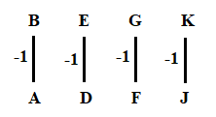
Alphabet Analogy
1) BEGK is related to ADFJ in the same way as PSVY is relate to ?
2) BLOCKED : YOLXPVW :: ? : OZFMXS?
Sol) clearly each letter in the first group occupies the same position from the beginning of the alphabet as is occupied by the corresponding letter of the second group from the end of the alphabet.

Slide 52
3) AG:IO::EK:?
Sol) Each letter of the first group is moved EIGHT steps forward to obtain the corresponding letter of the second group.
4) ADE:FGJ::KNO:?
Sol) 1st & 3rd places of 1st group: +5
5) LLAMS:SMALL
SRENID:DINERS
CHART:TRACH
BARK:KRAB
TREE:EERT
Sol) The second group is a meaningful word formed by reversing the order of the letters of the first group.

Slide 53
Double Analogy’s
1) SCHOOL: A: : HOSPITAL : B
A: a) student b) education c) knowledge d) books
B: 1) Doctor 2) Disease 3) Treatment 4) Medicines
Sol) First is an Institute to impact the second i.e., b3
2) ________ is to second as day s to _________
Sol) seconds make up a minute and hours make up a day.

Slide 54
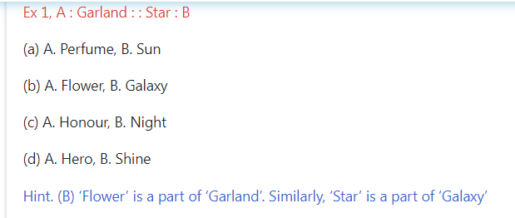
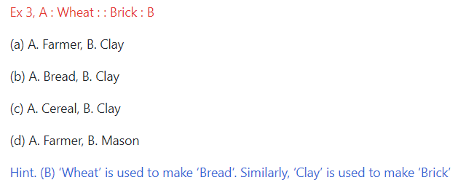
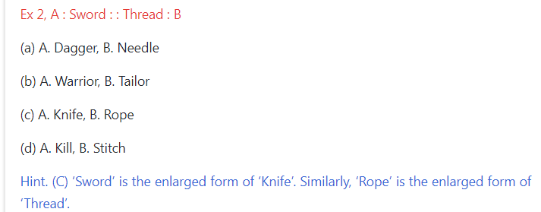
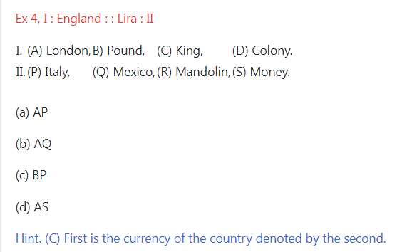
Double Analogy:

Slide 55
Choosing a similar word
1) LIVER: HEART:KIDNEY
Sol) Internal organs.
2) RICE:WHEAT:MAIZE
Sol) All are food crops.
3) PATHOLOGY:CARDIOLOGY:RADIOLOGY:OPTHALMOLOGY
Sol) All are branches of medical science.
4) Which of the following is the same as FLOOD, FIRE, CYCOLNE?
Sol) All are natural calamities.
5) Which of the following is the same as CYGNUS, PLEIDES, SCORPIO?
Sol) All are related to Zodiac signs.

Slide 56
Detecting Analogies
In this type questions, the candidate is required to trace out the hidden analogy or common characteristic among the given words or to choose the word which mentions the quality’s common to the given words.

Slide 57
1) JUDO:KARATE:TAEKWANDO
They are names of martial arts
They can be performed by obese persons
They are performed on stage
They are important items of Asian games
Sol) Option (a) is the most suitable description for all the three.

Slide 58
Multiple-word analogy
In this type of questions, a group of 3 or 4 inter related words is given. The candidate is required to trace out the relationship among these words and choose another group with similar relationship, from amongst the alternatives provided.

Slide 59
problems
1) PEN:PENCIL:INK
ORANGE:BANANA:JUICE
TABLE:CHAIR:WOOD
COW:MILK:CURD
FISH:SHARK:WATER
Sol) clearly, pen contains ink and pencil belongs to the same category as pen i.e., Stationary. Similarly orange contains juice and banana belongs to the same category as orange. i.e., fruits.

Slide 60
2) FURNITURE: TABLE: ALMIRAH
BUILDING:WALL:BRICK
FRUIT:ORANGE:MANGO
MOTHER:FATHER:SISTER
SEA:ROAD:CITY
Sol) Both second and third belong to the class denoted by the first. i.e., FRUIT:ORANGE:MANGO
3) IRON:SILVER:GOLD
PARENTS: FATHER:MOTHER
WHEAT:BARLEY:CEREAL
TREE:BRACH: FRUIT
DEER:LION:WOLF
Sol) All the three belongs to the same category i.e., they are metals i.e., DEER:LION:WOLF

Slide 61
Classification
Classification means to assort the items of a given group on the basis of certain common quality they possess and then spot the stranger or odd one out.
In this test, you are given a group of certain items, out of which all except one are similar to one another in some manner.
The candidate is required to choose this one item which does not fit into the given group.

Slide 62
Type 1: Choosing the ODD word:
Directions: Choose the word which is least like the other words in the group.
1)
Zebra
Lion
Tiger
Horse
Giraffe
Sol) Here, all except Horse, are wild animals, while horse can be domesticated.
2)
Parrot
Bat
Crow
Sparrow
Pigeon
Sol) Here, all except bat, belong to the class of Aves(birds), while bat is mammal.

Slide 63
3)
Copper
Zinc
Brass
Aluminum
Iron
Sol) Here, all except brass are metal, while Brass is an alloy
4)
Amethyst
Ruby
Marble
Sapphire
Diamonds
Sol) Here, all except marble are precious stones.

Slide 64
5)
Feeling
Joy
Anxiety
Anger
Sorrow
Sol) All other denote the various feelings

Slide 65
Type:2 Choosing the ODD pair of words
1)
Blacksmith: Anvil
Carpenter: Saw
Barber: Scissors
Goldsmith: ornaments
Sculptor : chisel
Sol) In all other pairs second is the tool used by the first.
2)
Flurry: blizzard
Moisten: drench
Prick: stab
Scrub: polish
Sol) In all other pairs second is of higher intensity than the first.

Slide 66
3)
Hard: soft
Long: high
Sweet : sour
Pointed: blunt
Sol) All other except (b) are antonyms of each other.

Slide 67
Type:3 Choosing the ODD numeral
1)
131
151
161
171
191
Sol) The sum of the digits of each of the nos except 161 is an odd number
2)
48
50
82
170
290
Sol) Each of nos except 48, is one more than the square of a certain number

Slide 68
3)
13
17
23
37
73
Sol) Prime nos: Reversing order also get prime nos or sum of digits
4)
25631
33442
34424
52163
Sol) sum of digits = 17

Slide 69
5)
2468
2648
4826
6482
Sol) In all other nos contains first four consecutive even nos but not in proper order.

Slide 70
Type:4 Choosing the ODD numeral pair/group
1)
71, 7, 3, 17
67, 71, 3, 5
41, 5, 3, 47
37,14, 19,7
11, 13, 3, 17
Sol) All other groups except (d) consists of prime nos only
2)
22-3
28-4
36-5
43-6
50-7
Sol) In all other pairs, the first no when divided by the second no leaves 1 as remainders.

Slide 71
3)
12-42
14-82
23-64
36-72
Sol) In all other pairs the sum of the digits of the second no is twice the sum of the digits of the first no.

Slide 72
Type: 5: Choosing the ODD letter group
In this type of questions usually five groups of letter are given. Four of them are similar to each other in same manner while one is different and this is to be chosen by the candidate as the answer.
1)
BD
IK
PN
SU
WY
Sol) All other groups consist of two alternate letters in order, while in this group they are in reverse order

Slide 73
2)
BDW
DFU
FHS
GIQ
IKP
Sol) In all other groups the first two letters are alternate, while 2nd & 3rd letters occupy the same positions from the beginning and the end of the alphabet respectively.
3)
CEAR
DEAR
NEAR
WEAR
TEAR
Sol) Meaningful words

Slide 74
Coding – Decoding
A code is a system of signals therefore coding is a method of transmitting a message between the sender and the receiver without a 3rd person knowing it.
The coding and decoding test is set up to judge the candidates ability to decipher the rule that codes a particular word/ message and break the code to decipher the message.

Slide 75
Letter coding
In these questions the letter in a word are replaced by certain other letters according to a specific rule to form its code. The candidates is required to detect the code coding pattern /rule and answer the questions accordingly.
Case 1: To form the code for another word (CODING)

Slide 76
Problems
1) In a certain code TEACHER is written as VGCEJGT how is CHILDERN written in that code?
Sol)
Clearly each letter in the word TEACHER is moved two steps forward to obtain the corresponding letter of the code.
T E A C H E R
+2 +2 +2 +2 +2 +2 +2
V G C E J G T
Similarly we have
C H I L D R E N
+2 +2 +2 +2 +2 +2 +2 +2
E J K N F T G P
We get the required code i.e EJKNFTGP

Slide 77
2) In a certain code BREAKTHROUGH is written as EAOUHRBRGHKT, how is DISTRIBUTION written in that code?
Sol)
Let us divide the letters of the given word into pairs and label these pairs from 1 to 6
BR EA KT HR OU GH
1 2 3 4 5 6
Clearly the code contains these pairs arranged in the order 2, 5, 4, 1, 6, 3
DI ST RI BU TI ON
1 2 3 4 5 6
Arranging these in the order 2, 5, 4, 1, 6, 3
We get the required code i.e., STTIBUDIONRI

Slide 78
Case 2: To find the word by analyzing the given code DECODING
1) If in a certain language POPULAR is coded as QPQVNBS, which word would be coded as GBNPVT?
Sol) Each letter of the word in one step behind the corresponding letter of the code. So,
We get the required code as FAMOUS.
2) In a code language SOLID is written as WPSLPIMFHA, what does the code word ATEXXQIBVO refer to?
Sol) Clearly the word can be obtained by moving the letter at even numbered position in the code, three steps forward and omitting these at odd numbered positions.
We get the required code as WATER

Slide 79
Direct Letter Coding
What we have studied so far was ‘Rule-Coding’ in which letters were assigned codes according to a set pattern or rules concerning the movement or re ordering of letters and one needs to detect this hidden rule to decode a message. But, sometimes particular letters are made codes for particular letters without these being any set pattern.

Slide 80
Problems
If the word EARTH be written as QPMZS is coded form. How can HEART be written following the same coding?
Sol) Observing we may notice that HEART consists of the same letters as EARTH and the four possible codes given as alternatives also consists of the same letter codes as those in the code for EARTH. This indicates that this is a question on direct coding.
Thus we have:
Letter: E A R T H
Code: Q P M Z S

Slide 81
2) In a particular way of coding the word CENTRAL is coded as ABCDEFG and PLANETARIUM as HGFCBDFEIJK with the same coding how can we express the word LANTERN?
Sol) Letter: C E N T R A L P I U M
Code: A B C D E F G H I J K
Therefore: LANTERN: GFCDBEC

Slide 82

Number/symbol coding
Case 1: when numeral/symbol codes are assigned to words
1) If MACHINE is coded as 19-7-9-14-15-20-11, how will you code DANGER?
Sol) Respective position of the letter +6: to obtain the code.
2) If RED is coded as 6720, then how would GREEN ?
Sol) RED ------ DER ------ 4/5/18 ------- (4+2)/(5+2)/(18+2)--------- 6/7/20 (club: 6720)
Our required code is 1677209.
3) If E=5, and HOTEL=12, how will you code LAMB?
Sol) We have A=1, B=2,…… Y=25, Z=26.
Thus, HOTEL = $\frac{H+O+T+E+L}{5}=\frac{60}{5}=12$
Therefore LAMB = $\frac{28}{4}=7$

Slide 83
Case 2: when alphabetical codes are assigned to numbers
Problems:
1) If 453945 stands for DECIDE, then decode 8978?
Sol) Clearly the no is replaced by the letter at that position in the English alphabet.
Therefore we get HIGH
2) If 123 stands for 987, then 234 stands for?
Sol) In the given system of coding a number X is coded as (10-x).
Thus, 234-------- 876.

Slide 84
Matrix Coding
Case 1: A letter from the matrices can be represented 1st by its row and then the column number
 | 0 | 1 | 2 | 3 | 4
0 | F | O | M | S | R
1 | S | R | F | O | M
2 | O | M | S | R | F
3 | R | F | O | M | S
4 | M | S | R | F | O
 | 5 | 6 | 7 | 8 | 9
5 | A | T | D | I | P
6 | I | P | A | T | D
7 | T | D | I | P | A
8 | P | A | T | D | I
9 | D | I | P | A | T
Matrix-1
Matrix-2

Slide 85
1) MOST:
Sol)
From Matrix 1, m is coded as: 02, 14, 21, 33 or 40
From Matrix 1, o is coded as: 01, 13, 20, 32 or 44
From Matrix 1, s is coded as: 03, 10, 22, 34 or 41
From Matrix 2, t is coded as: 56, 68, 75, 87 or 99

Slide 86
Case 2: A letter in a cell is represented 1st by its column number and then its row number.
Problems:
1) Consider the same above example with the same word?
Sol)
From Matrix 1, m is coded as: 04, 12, 20, 33, 41
From Matrix 1, o is coded as: 02, 10, 23, 31, 44
From Matrix 1, s is coded as: 01, 14, 22, 30, 43
From Matrix 2, t is coded as: 57, 65, 78, 86, 99
Along with the same 4 options, e is coded as: 20, 23, 22, 78

Slide 87
Substitution
In this type of questions, some particular words are assigned certain substituted names. Then a question is asked that is too answered in the substituted code language.

Slide 88
Problems
1) If diamond------ gold, gold------- silver, silver------ruby, ruby--------emerald, which is cheapest jewel?
Sol) we know silver is cheapest
2) If white is called Blue, blue--------red, red-------yellow, yellow--------green, green----black, black----- violet, violet------orange, what would be the color of human blood?
Sol) Yellow
3) If sky is star, star is cloud, cloud is earth, earth is tree, tree is book, then where do the birds fly?
Sol) birds fly in sky; and as given sky is star.
So, birds fly in the star

Slide 89
Deciphering message word codes
In this type of questions some messages are given in the coded language and the code for a particular word or message is asked. To analyze such codes, any two messages bearing a common word are picked up. The common code word will represent that word. Proceeding similarly by picking up all possible combinations of two, the entire message can be decoded and the codes for individual words found.

Slide 90
Problems
1) In a certain language, “sun shines brightly” is written as ‘ba lo sul’, ‘houses are brightly lit’ as ‘kado ula ari ba’ and ‘light comes from sum’ as ‘dopi kup lo nro’. What code words are written for ‘sun ’ & ‘brightly’?
Sol)
In the 1st & 3rd sentence, the common word is ‘sun’ and the common code word is ‘lo’. So, ‘lo’ is the code for ‘sun’
In the 1st and 2nd sentence, the common word is ‘bright’ and the common code word is ‘ba’. So, ‘ba’ is the code for ‘brightly’

Slide 91
Deciphering number and symbol codes for messages
1) In a certain code language, ‘123’ means ‘bright little boy’, ‘145’ means ‘tall big boy’ and ‘637’ means ‘beautiful little flower’. Which digit in that language means ‘bright’?
Sol)
In the 1st and 2nd statements the common code digit ‘1’ and the common word is ‘boy’. So, ‘1’ means ‘boy’.
In 1st and 3rd statements the common code digit is ‘3’ and the common word is ‘little’. Thus, in 1st statement ‘2’ means ‘bright’

Slide 92
JUMBLED CODING

Slide 93
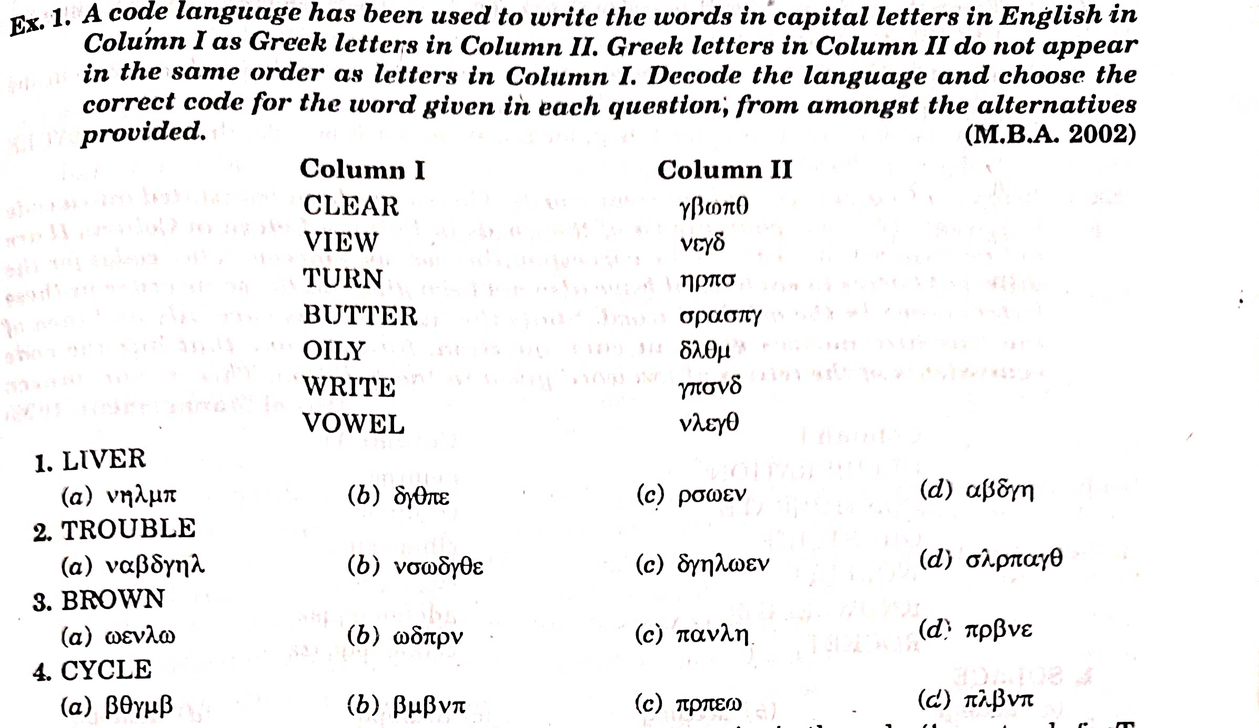

Slide 94
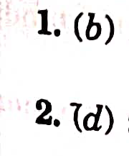


Slide 95

Crypt athematic problems
1Q. LET + LEE = ALL , then A + L + L = ? Assume (E=5, T=6)
1.L 2.A 3. E 4.T
Sol.

Slide 96

2. If KANSAS + OHIO = OREGON Then find the value of G + R + O + S + S (where O=5)
a. 7 b. 8 c.9 d.10

Slide 97

3.HERE = COMES - SHE, (Assume S = 8) Find the value of R + H + O
a. 12 b.13 c.14 d.15

Slide 98




EX:
EX;

Slide 99

INPUT OUT PUT TRACING

Slide 100


Slide 101



Slide 102




Slide 103



Slide 104


Slide 105


Slide 106



Slide 107




Slide 108


Slide 109


Slide 110


Slide 111


Slide 112


Slide 113


Slide 114



Slide 115


Slide 116



Slide 117



Slide 118


Continuous pattern series

Slide 119



Slide 120


Slide 121


Slide 122


Slide 123


Slide 124


Slide 125


Slide 126


Slide 127


Slide 128


Slide 129


Slide 130



Slide 131



Slide 132



Slide 133
Thank you

